Slide 1
LISK SDK & Sidechain

Slide 2
LISK SDK
Open source
Beta
Javascript/Typescript
Node.JS
Geen Windows
Docker image voor windows
PostgreSQL
API
Websockets

Slide 3
LISK SDK
5 voorbeeldprojecten
https://github.com/FlorisFeddema/lisk-sdk-examples
Forked van LISK
Hello world werkt
Cashback staan custom transactions in

Slide 4
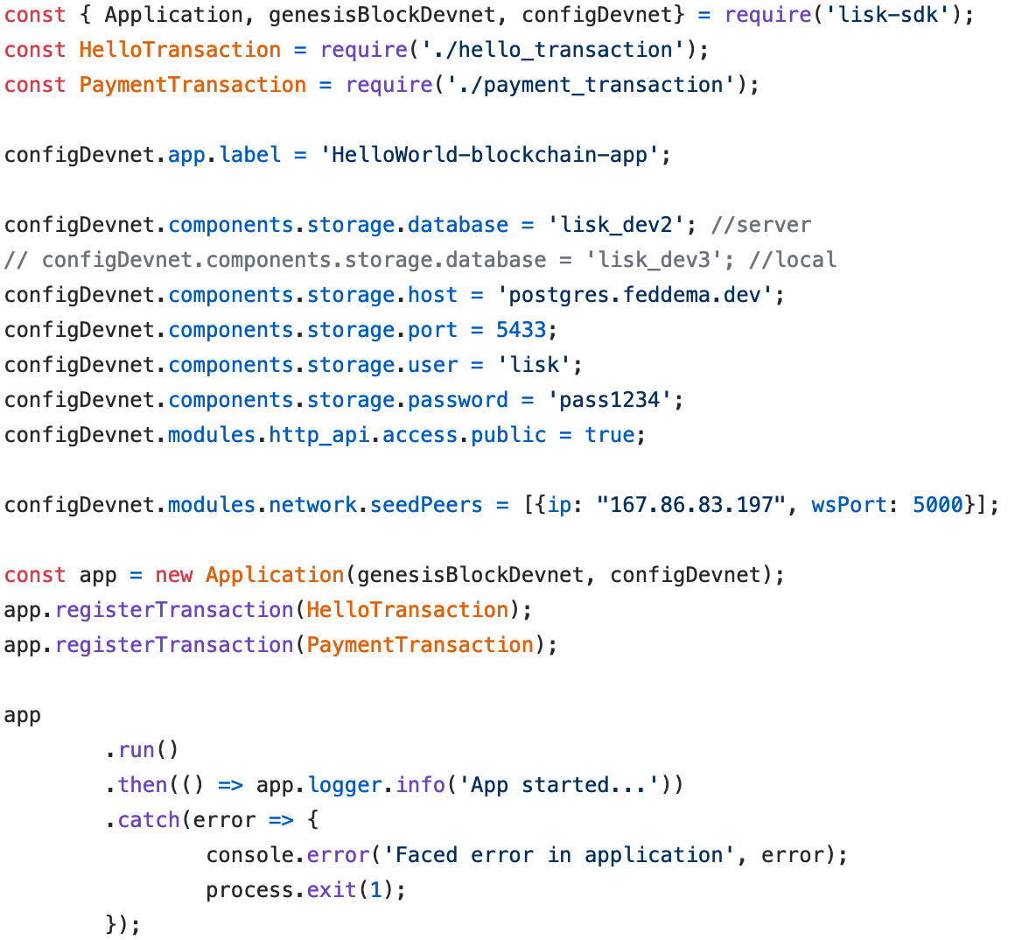
Hello_world
index.js
Devnet
Hello transaction
Payment transaction
Storage options
seedPeers

Slide 5
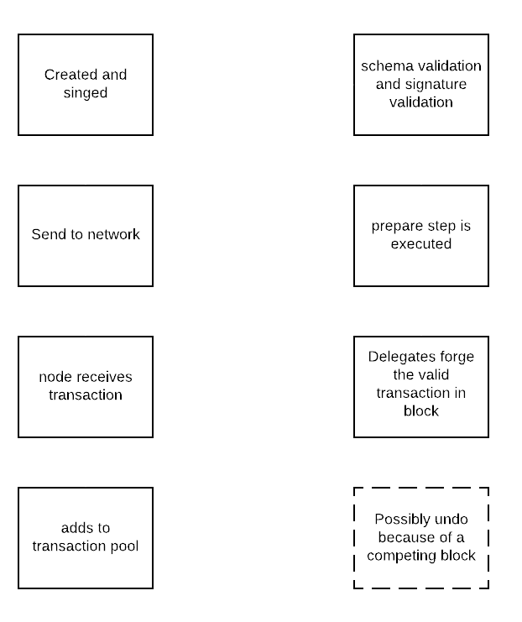
Transaction
Type -> 0-12 reserved
Asset
RecipientId
NetworkIdentifier
Timestamp
Amount -> Payment
Sign met passprase

Slide 6
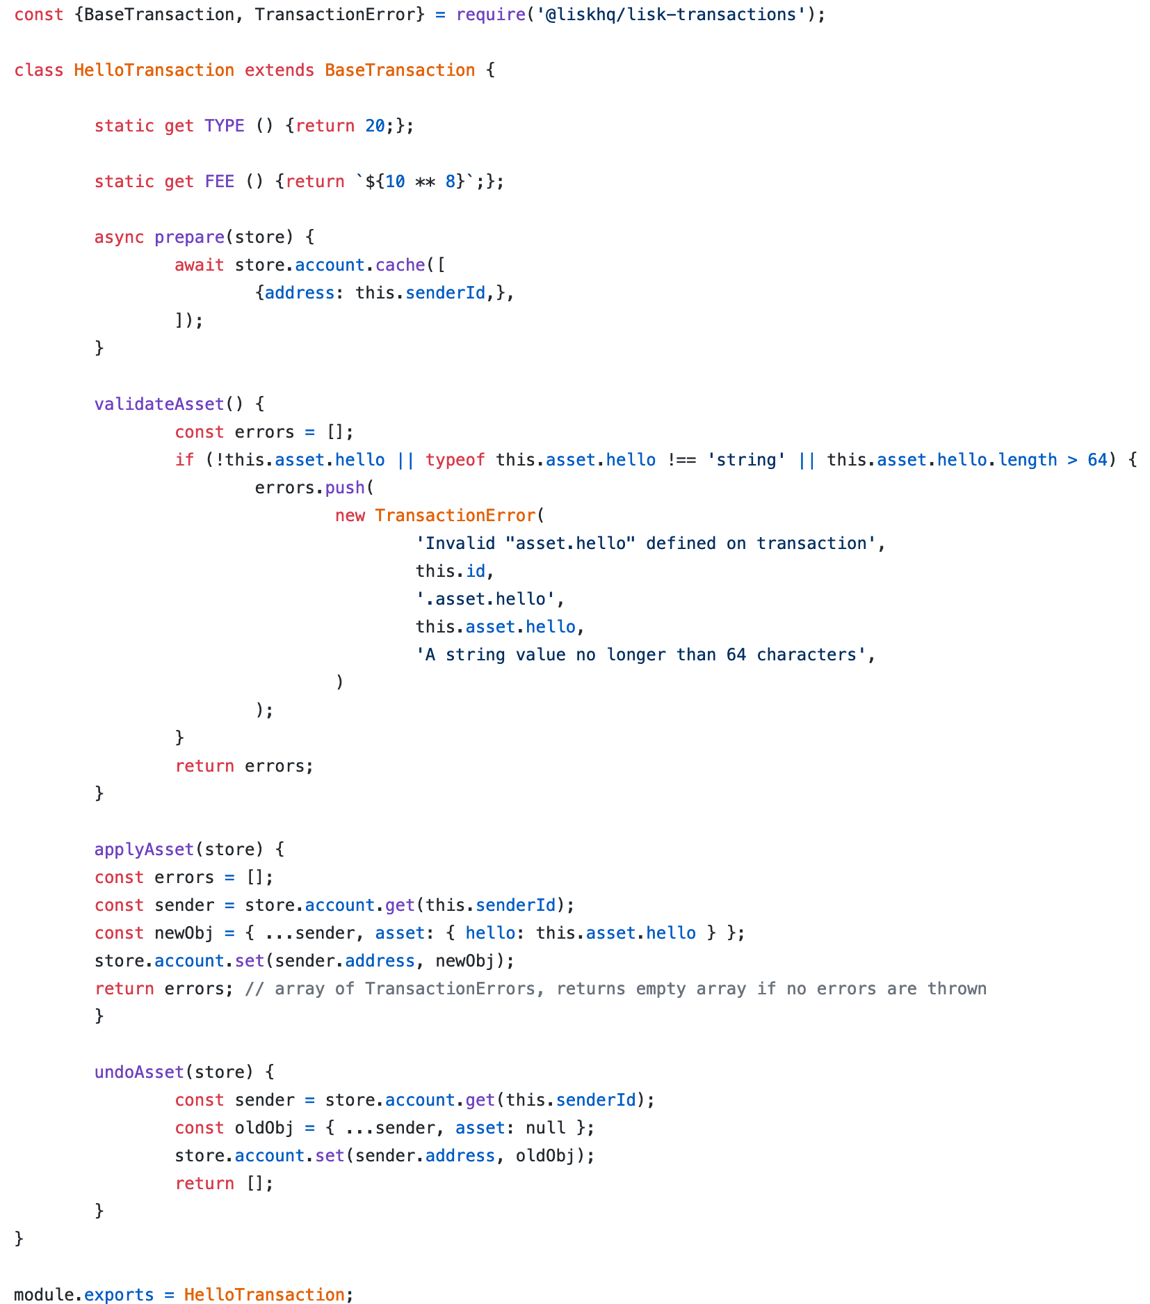
Hello_world
HelloTransaction.js
Base transaction
Type
Fee
Prepare
validateAsset
applyAsset
undoAsset

Slide 7
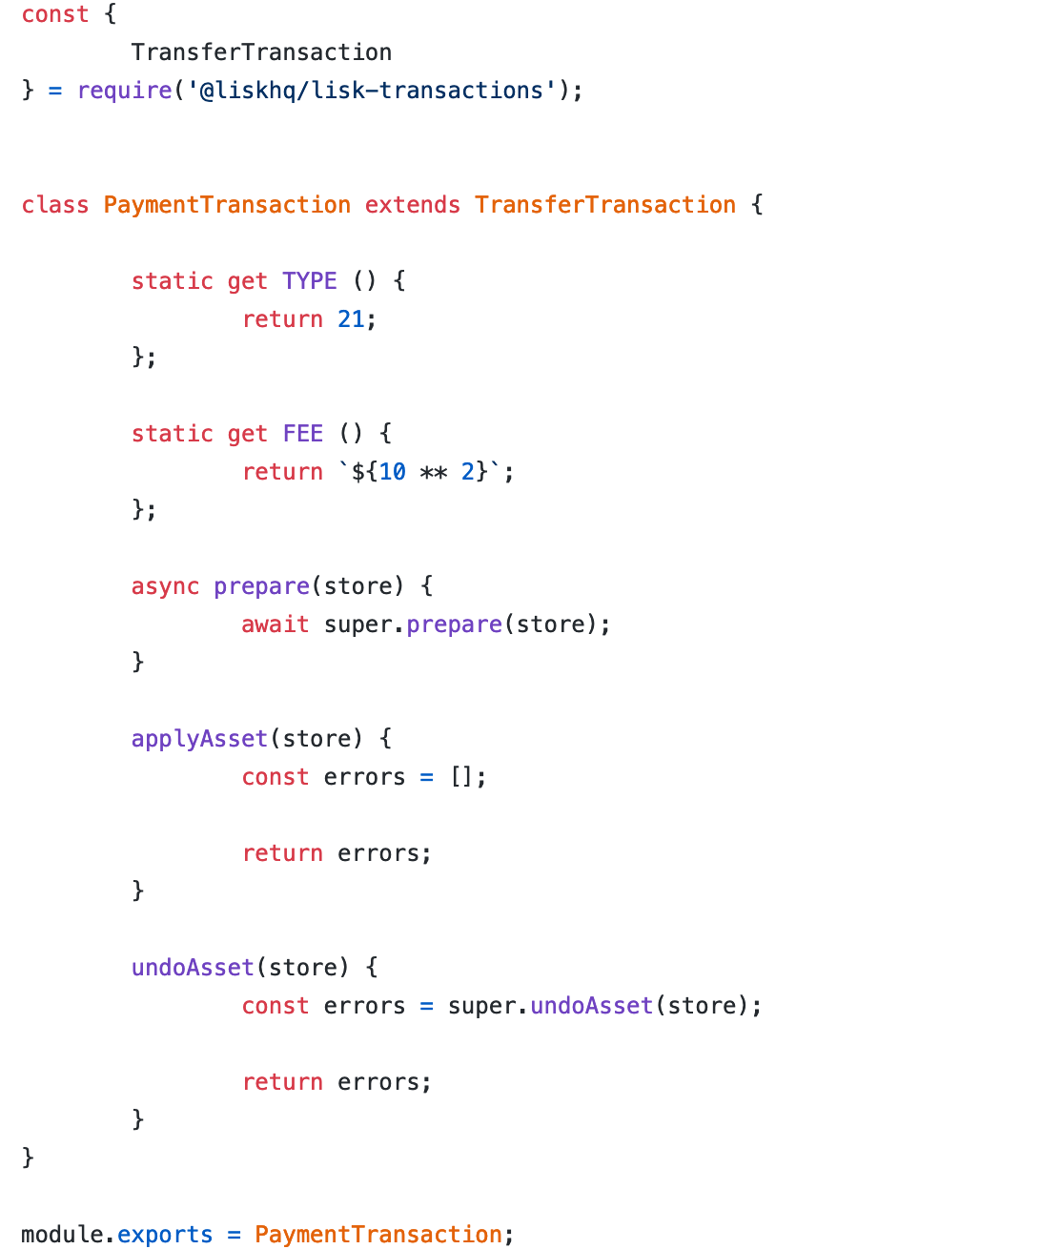
Hello_world
PaymentTransaction.js
TransferTransaction

Slide 8
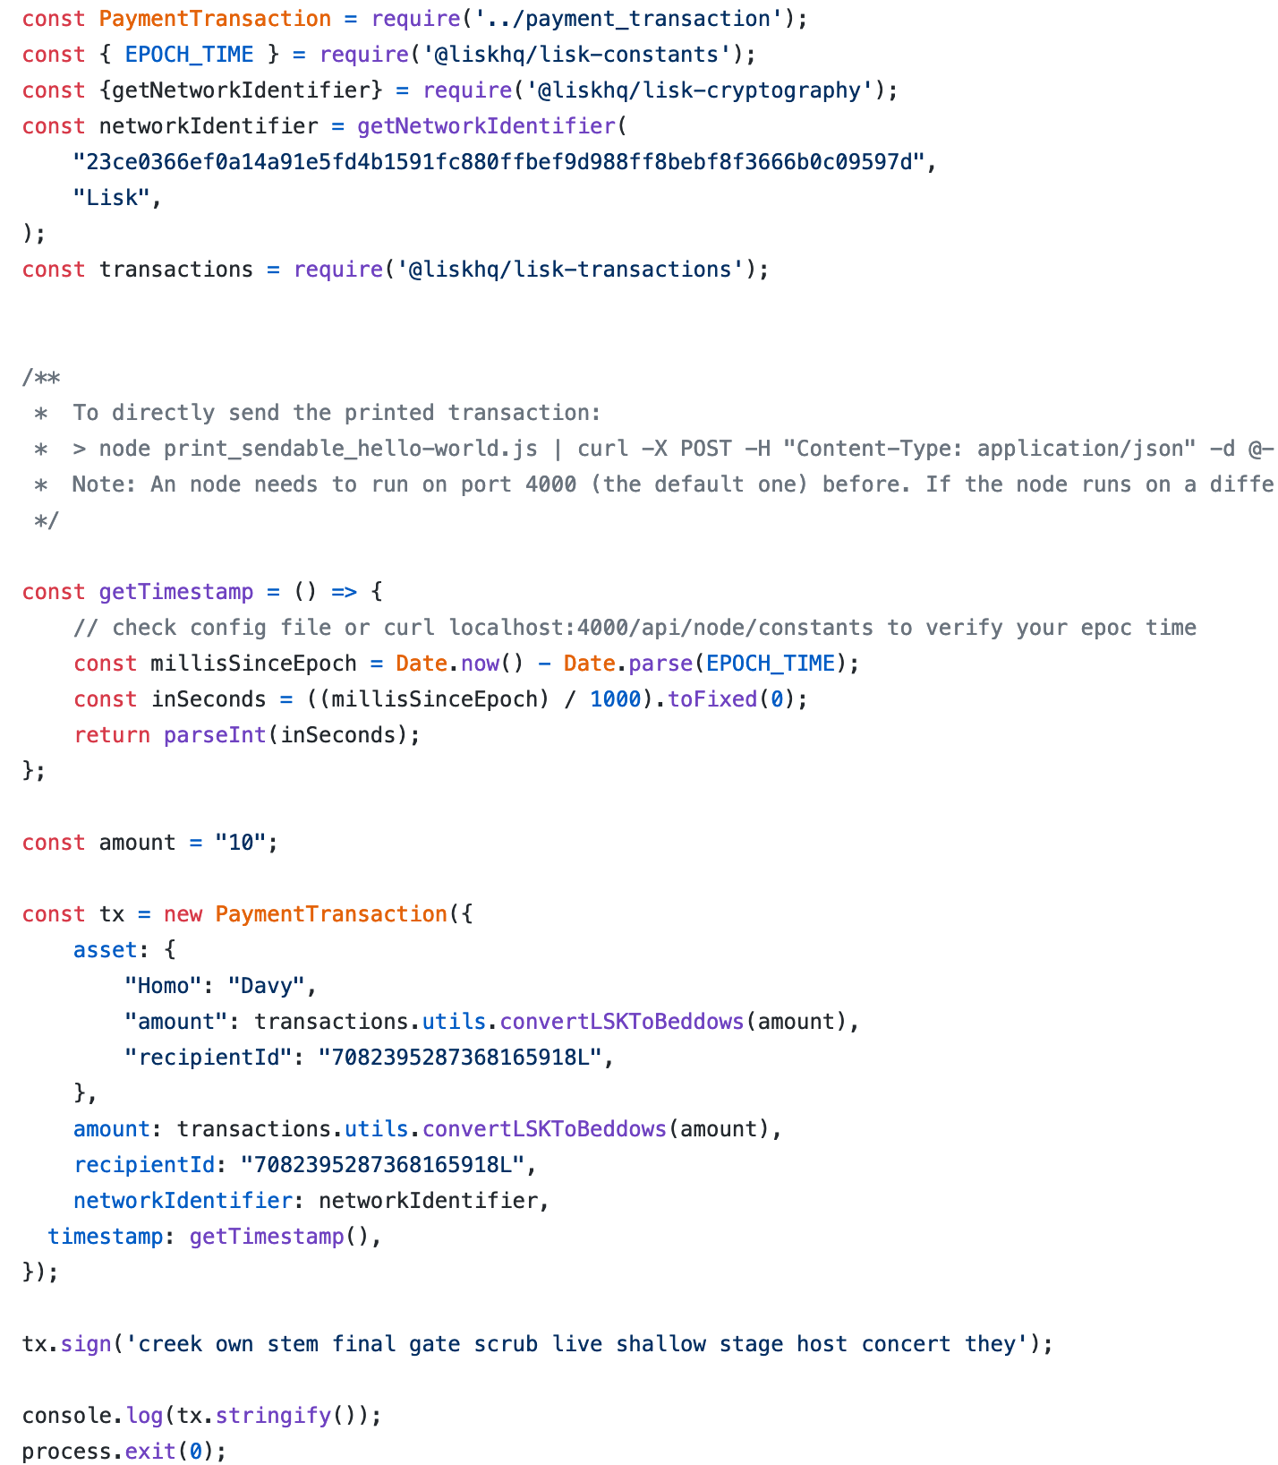
Hello_world
Send_payment.js
PaymentTransaction
Stuurt request naar network

